Slide 1
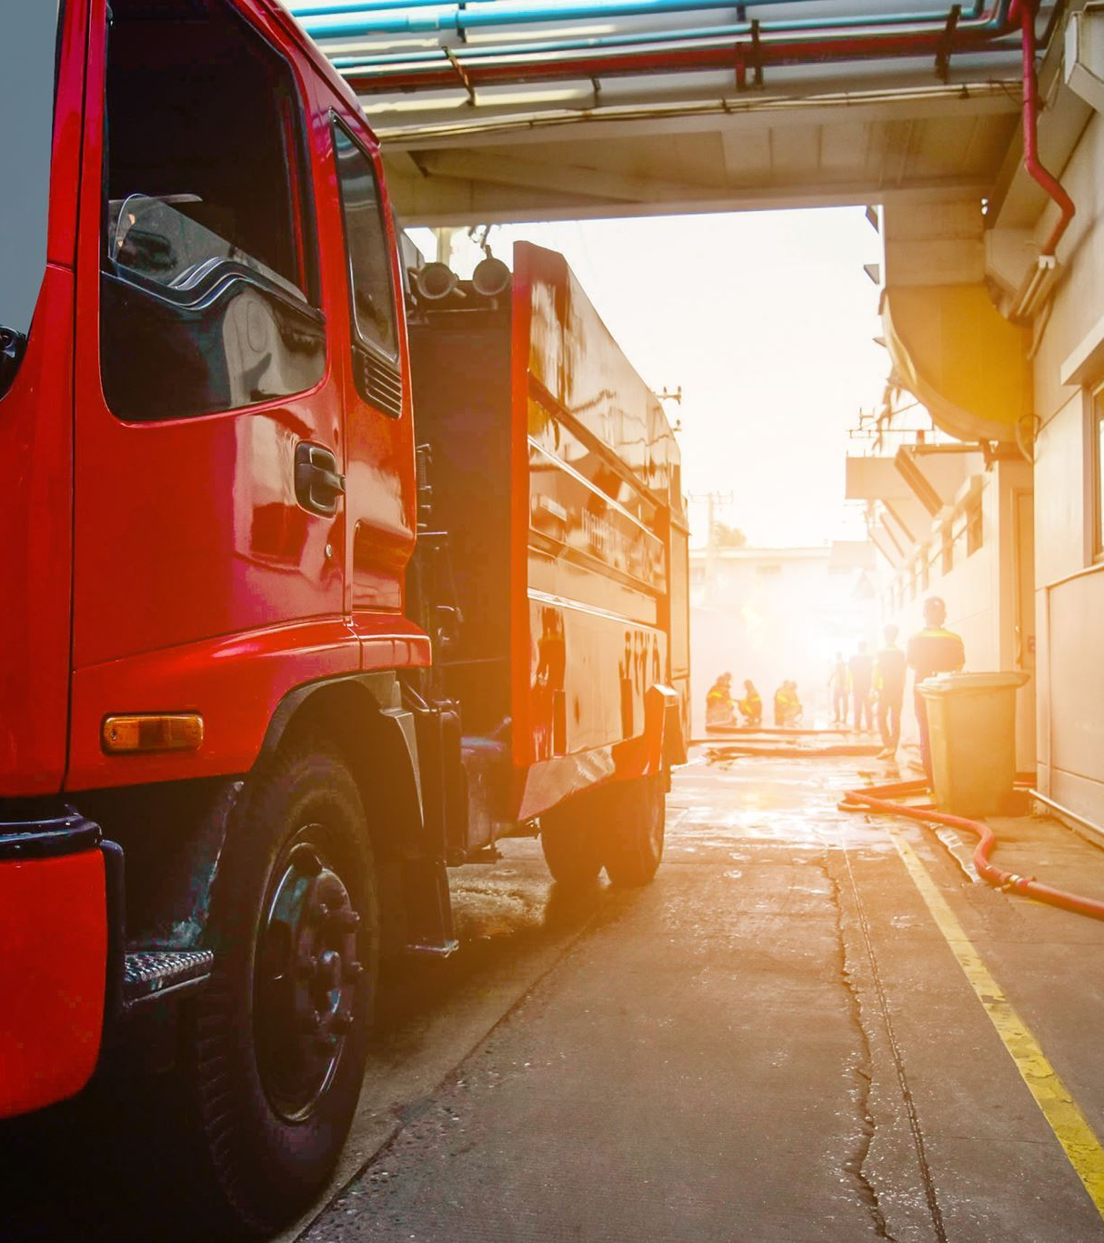
Truck Fleet Analysis
Group 3-
Shoun Jacob
Chaithanya Kuchally Jagadishbabu
Raga Rasagna Paruchuri
Sucharitha Bhukya
Satya Venkata Siva Prudhvi Palacharla

Slide 2
Problem Statement:
Az National Trucking (ANT), a national trucking corporation headquartered in California, must ensure that all the drivers in the fleet are in compliance with the rules and regulations of the corporation and do not present an insurance risk due to factors including speeding, unsafe following, lane departure, and other unsafe driving practices.
Objectives:
Accidents caused by large trucks are among the leading causes of injuries and deaths in the United States. The aim is to identify dangerous commercial truck drivers based on various factors.
Truck fleet data is analyzed and refined, while truck movements are examined to understand the risks associated with commercial trucking.

Slide 3








PROCESS WORKFLOW DIAGRAM
VMware
Impala ODBC
Connector
Data Visualization
with R integration
Hive, Pig
Drawing conclusions from the Visualizations
HDFS
Data Collection

Slide 4
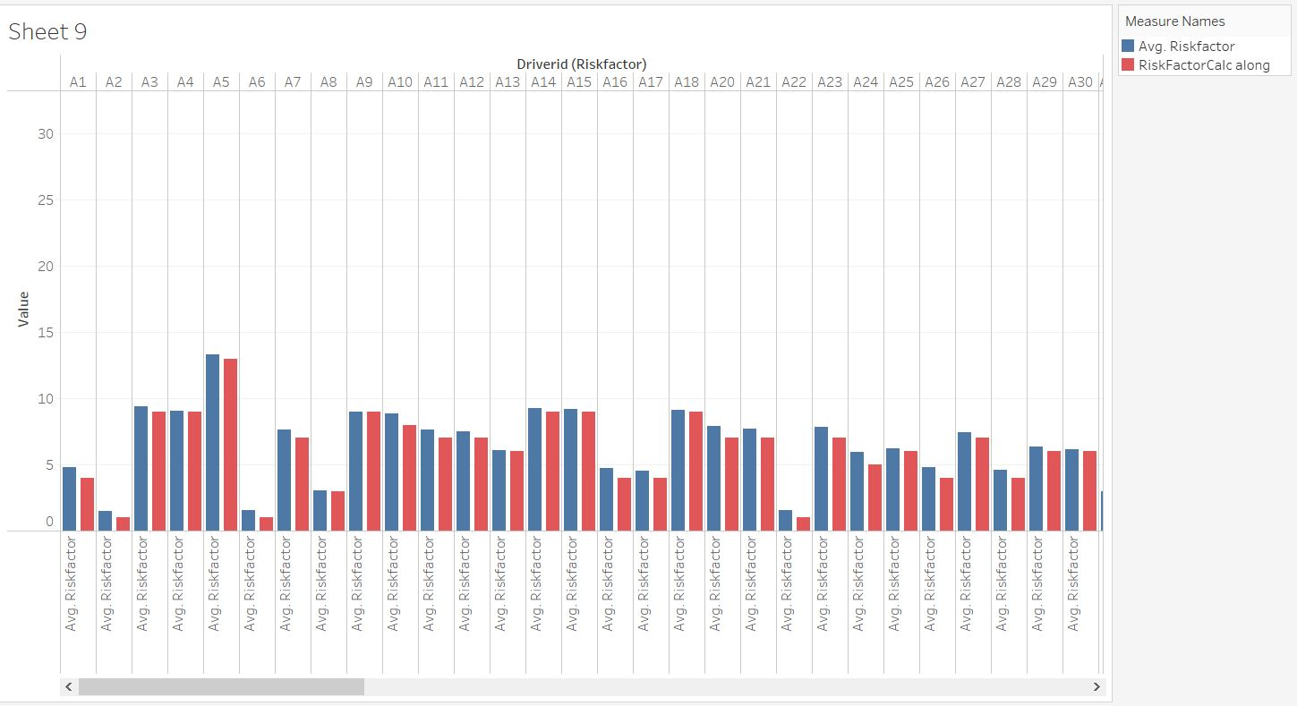
QUESTION 1: "HOW ACCURATE IS OUR CALCULATED RISKFACTOR, COMPARED TO REAL-WORLD DATA?"

Slide 5
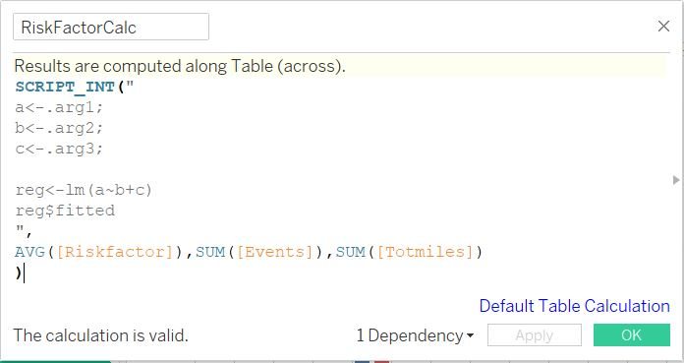
HOW WE INTEGRATED 'R'
WE USED THE R INTEGRATION TO CALCULATE THE RISKFACTOR BASED ON THE REAL-WORLD FACTORS THAT WE THOUGHT WOULD HELP DETERMINE HOW RISKY A DRIVER IS.
THEN, WE COMPARED IT TO THE RISKFACTOR VARIABLE WE HAD, AND DETERMINED THAT THE INITIAL CALCULATED VARIABLE IS MORE ACCURATE.

Slide 6
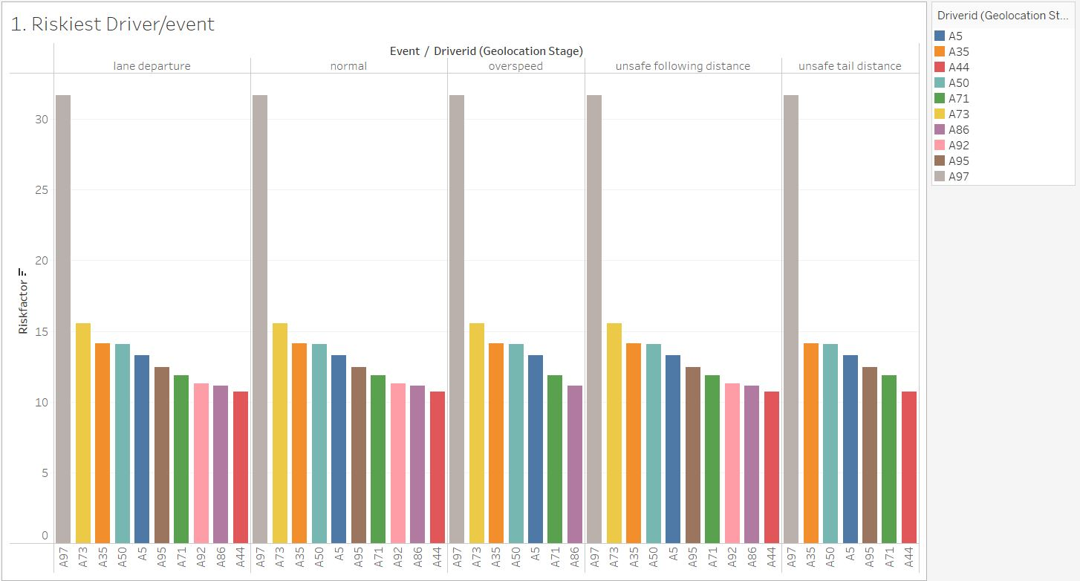
QUESTION 2: "WHO ARE THE RISKIEST DRIVERS, AND HOW FREQUENTLY DO THEY GET INVOLVED IN AN "EVENT"?"
DRIVER A73 IS CONSIDERED THE RISKIEST DRIVER IN ALL 4 TYPES OF EVENTS.
NOTE: WE ARE EXCLUDING 'A97' FROM OUR ANALYSIS, AS IT IS CONSIDERED AN OUTLIER.

Slide 7
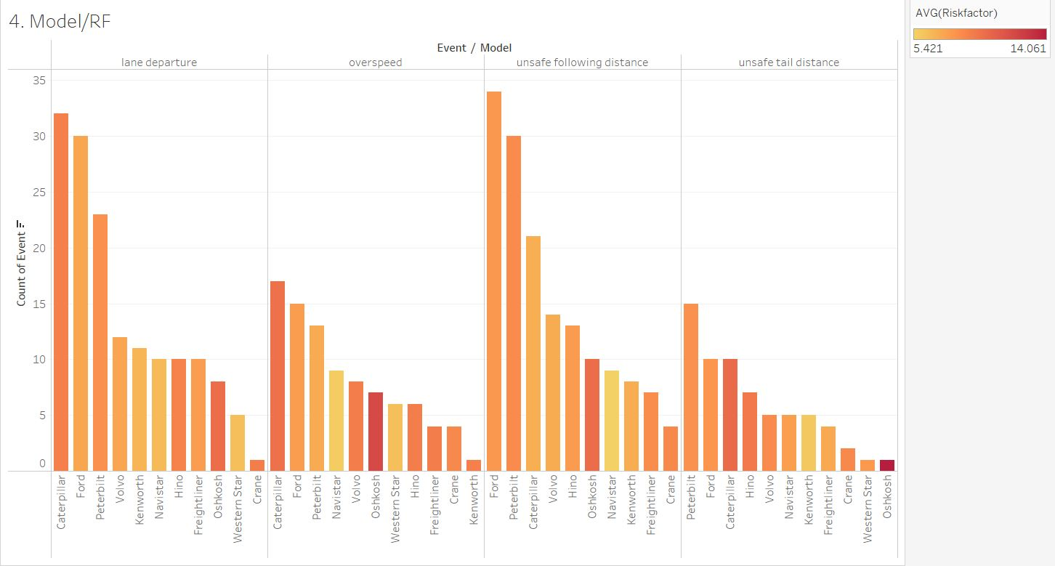
QUESTION 3: "WHICH MODELS ARE MOST "EVENT" PRONE?"
THE MODELS MOST PRONE TO THE 4 EVENTS:
LANE DEPARTURE: CATERPILLAR
OVERSPEED: CATERPILLAR
UNSAFE FOLLOWING DISTANCE: FORD
UNSAFE TAIL DISTANCE: PETERBILT

Slide 8
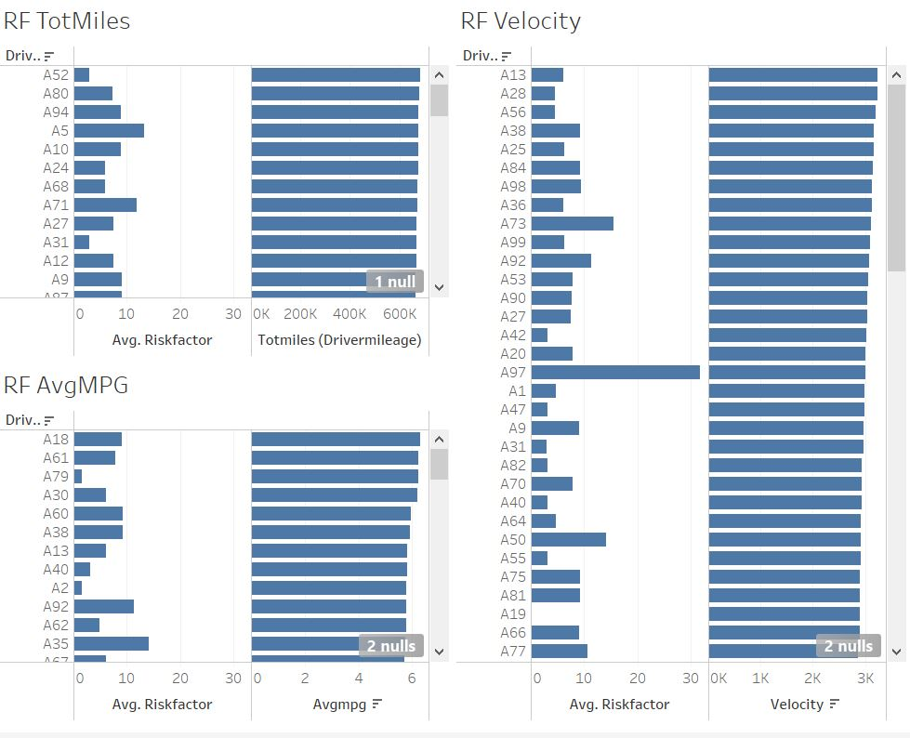
QUESTION 4: "DO OUR CHOSEN FACTORS DIRECTLY AFFECT THE RISKFACTOR?"
AS YOU CAN SEE HERE, OUR CHOSEN FACTORS (TOTMILES, AVGMPG, VELOCITY) DO NOT HAVE A DIRECT IMPACT ON THE DETERMINATION OF THE RISK FACTOR.
WE CONCLUDE THAT THERE ARE OTHER FACTOR THAT HELP CALCULATE THE SAME.

Slide 9
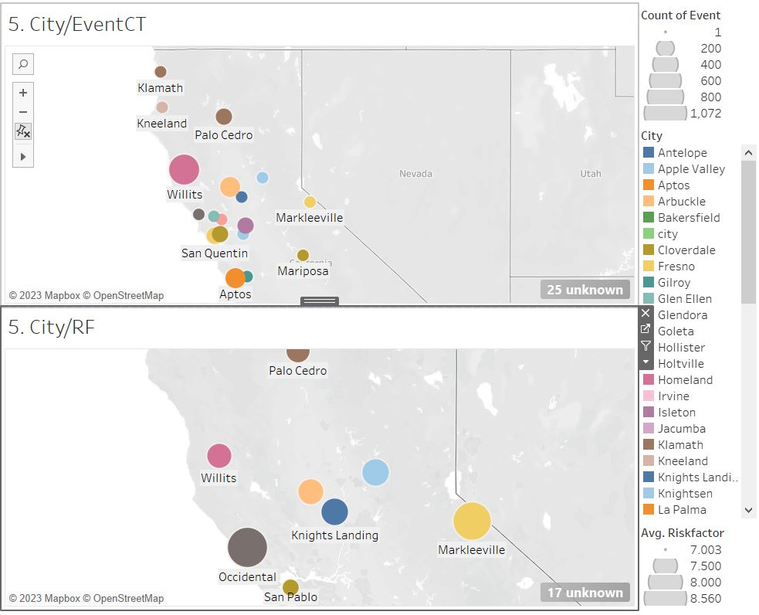
QUESTION 5: "WHICH CITY HAS THE RISKIEST DRIVERS AND MOST EVENTS?"
THE CITY OF WILLITS HAS THE HIGHEST NUMBER OF EVENTS (529).
THE CITY OF OCCIDENTAL HAS THE HIGHEST AVERAGE RISKFACTOR (8.294).
NOTE: WE HAVE ONLY INCLUDED THE CITIES WHICH HAVE AN AVERAGE RISK FACTOR > 7.

Slide 10
Challenges faced
Only the variables with a measure were used for Regression modeling in R.
Fixing a meeting time with the entire team while working on the project due to different schedules. However, we overcame it by distributing tasks.
On a Mac, the university VPN occasionally did not connect to work on the training environment.
Integrating Cloudera Hadoop with Tableau

Slide 11
Conclusion
The risk factor was influenced by the driver as well as external factors such as the truck's model, location, and the total number of miles driven.
Basing on the risks and dangerous events occurred, the drivers must go through comprehensive trainings.
Installing real-time monitoring devices that alert drivers when they violate safe driving practices such as following distance, lane departure, and over speeding.

Slide 12
Thank you

